Slide 1
Transit Oriented Development: Prospects for action on climate change
February 16, 2011
Presented to NYMTC
David King
Columbia University

Slide 2
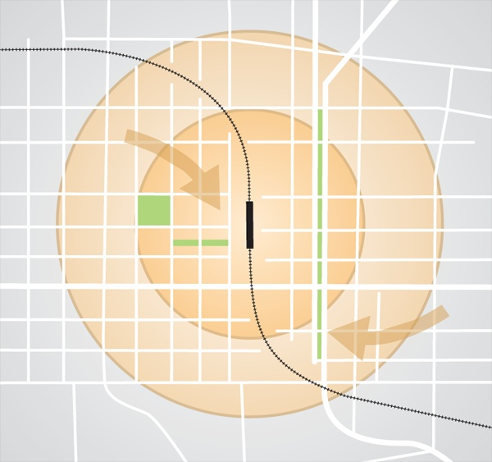
Transit-Oriented Development:
A quick overview
Centered on transit
  Most often rail
Walkable
Variety of uses and housing types
Public spaces
Image: RPA

Slide 3
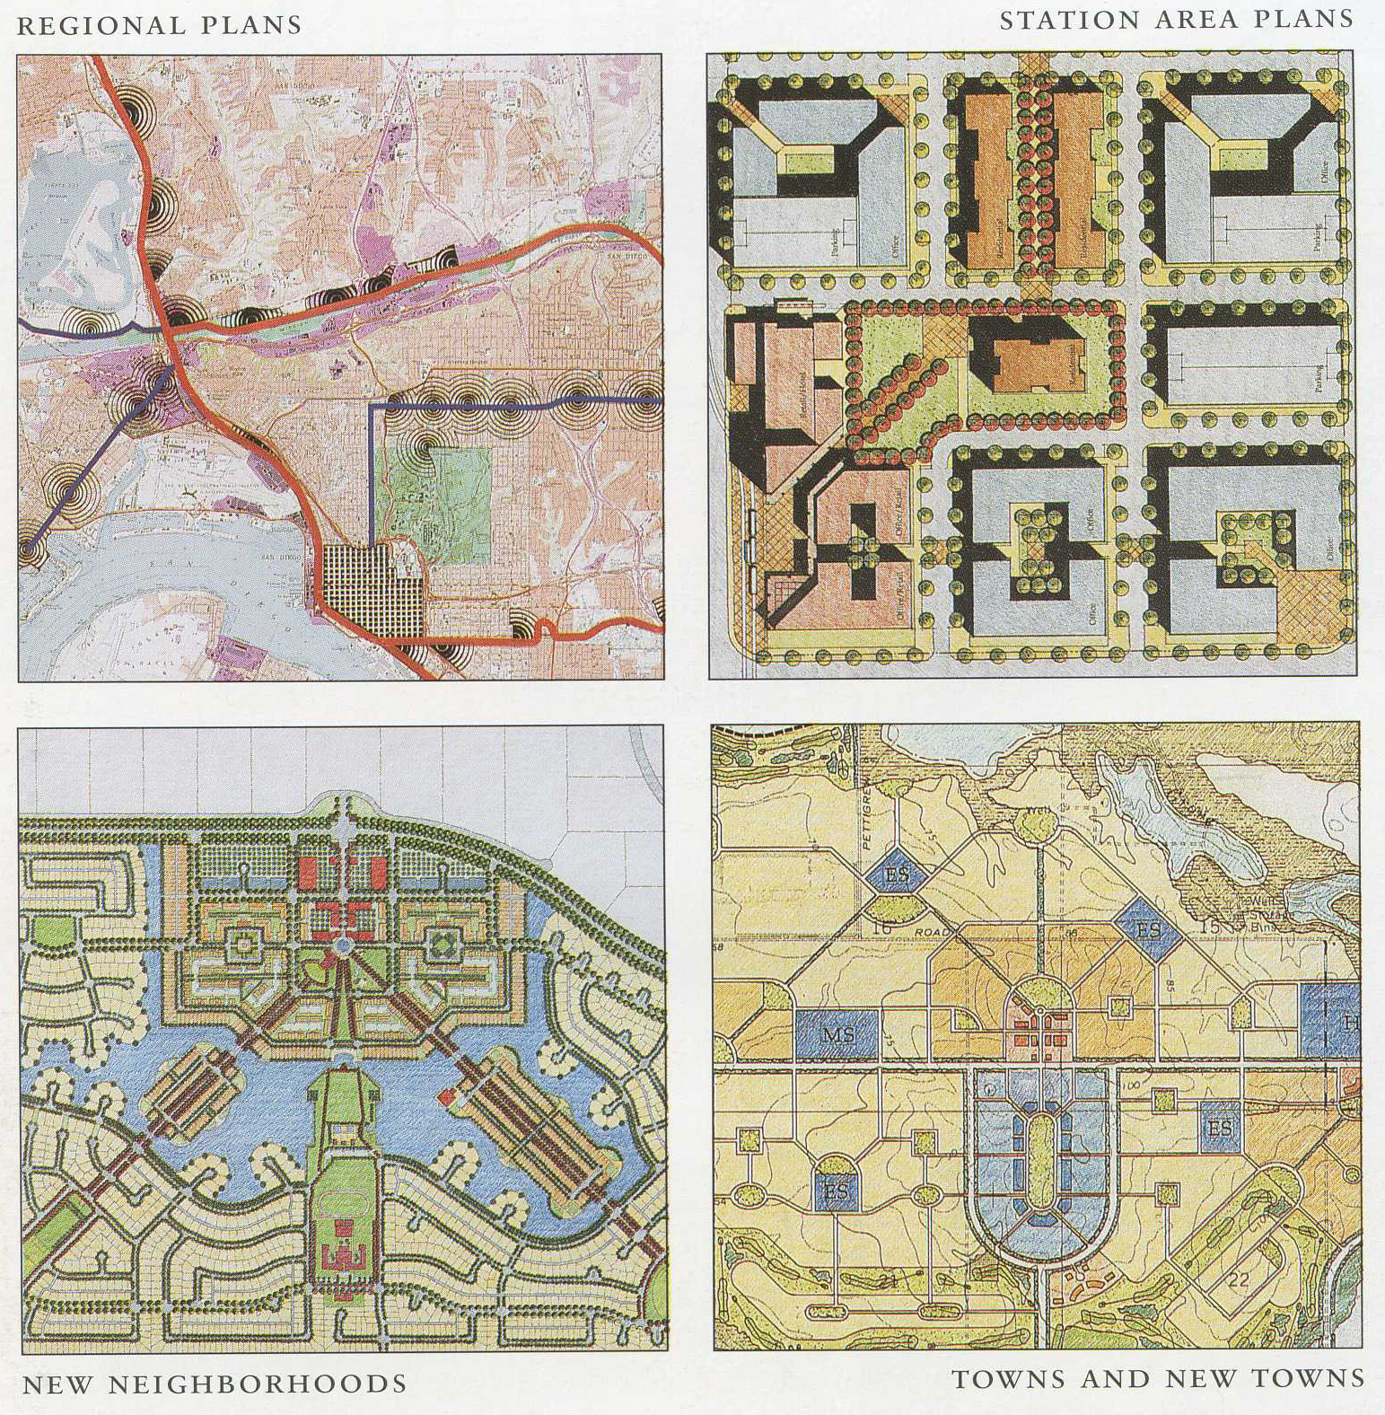
Source: Calthorpe

Slide 4
Parameters of a sustainable city
(Banister)
Population > 25,000 (> 50,000 is better)
Density > 40 persons/hectare (17/acre)
  @ 2.6 persons per household: 6.5 du/acre
  6,700 sq. ft. lot size
Mixed developments
Oriented to transit

Slide 5
Does TOD deliver?
Denser neighborhoods have lower VMT (vehicle miles traveled) per capita
  Shorter trips
  Mode shifts

Slide 6
Expected effects
 | Vehicles per household | Transit commute share | Walk commute share | VMT per capita
Density | -- | ++ | ++ | --
Strong center | - | ++ | + | -

Slide 7
Transport and the environment
Density is important for air quality and environmental benefits, but where the density occurs is as important
Largest potential gains are by redeveloping the core rather than densifying the suburbs

Slide 8
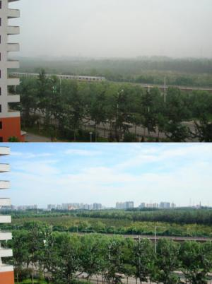

Slide 9
Elasticity of density
Midwestern MSA travel elasticity with respect to density is about -.35
  A 10 % increase in density will reduce travel by about 3.5 %
The reductions are largest in urban zones rather than suburban zones due to non-linear relationship between density and travel behavior

Slide 10
The reductions are largest in urban zones rather than suburban zones due to non-linear relationship between density and travel behavior
VMT elasticities:
  (-.43) urban
  (-.19) rural
In suburban and rural areas there is less opportunity to reduce non-work auto travel

Slide 11
The “Paradox of Smart Growth”
(NRDC)
Efforts to densify the suburbs will not be as effective as those in the central city
Redistributing population without overall population growth will unlikely lead to substantial gains in environmental and VMT measures

Slide 12
Where should TOD efforts go?
Redistribution versus growth
  Shifting current population and economic activity
  Creating new economic activity
Cities/regions that are not growing are not likely to see a decline in VMT and/or emissions from TOD

Slide 13
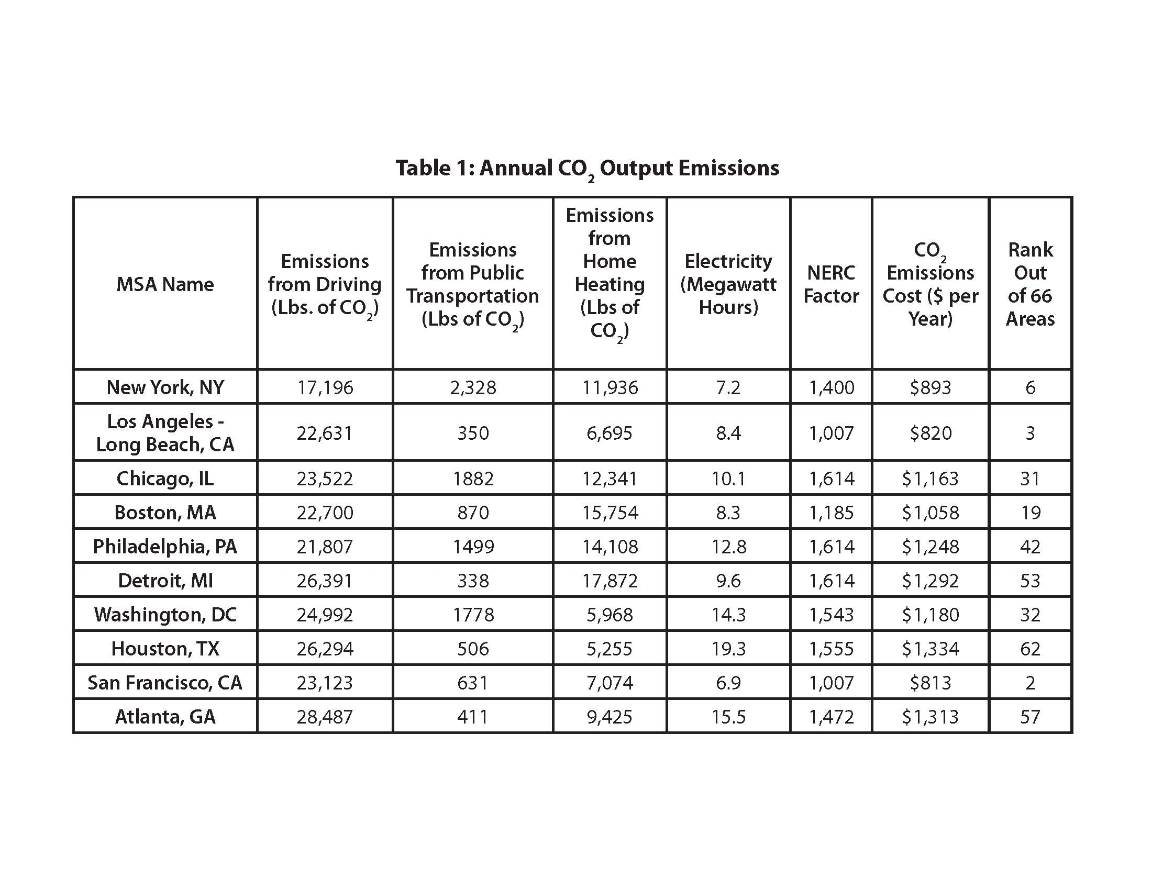

Slide 14
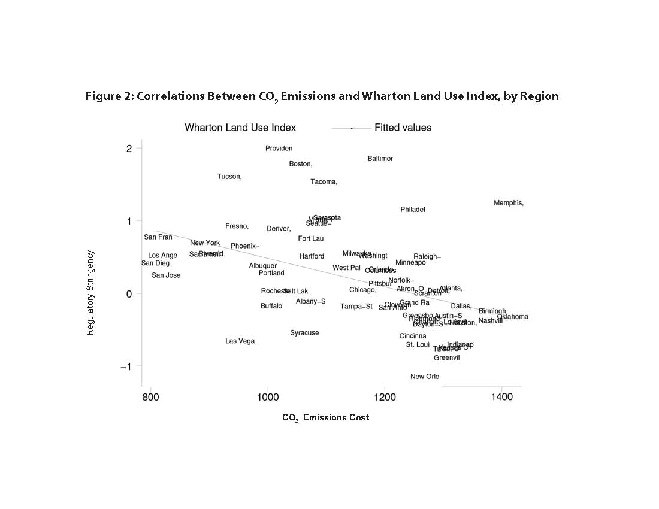

Slide 15
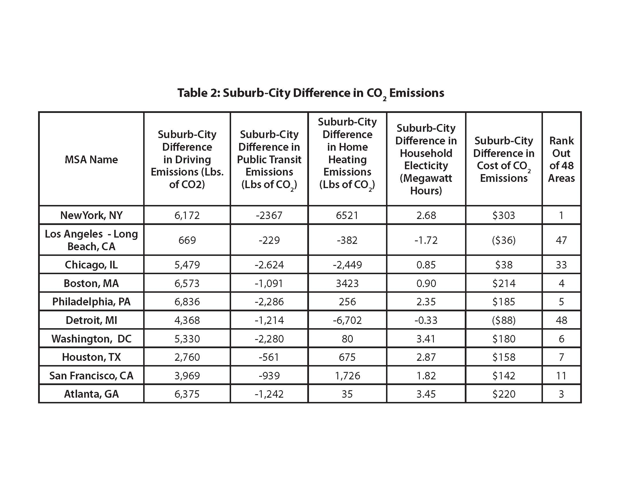

Slide 16
Obstacles to TOD
Land assembly
Parking requirements
Developer/lender resistance
Public opposition

Slide 17
Land assembly
TOD is best suited for areas where transit access already exists
  Greenfield TOD is rare and diminishes potential benefits
Large-scale, dense development requires assembling multiple parcels

Slide 18
Resolving land assembly
Eminent domain
Graduated density zoning
Density bonuses
Transferable development rights

Slide 19
Parking requirements
More parking=more driving
TOD with parking is effectively “parking oriented development”
Recent evidence in

Slide 20
Developer concerns
Few successful TOD projects to use as examples
  Market demand is unclear, though evidence suggests that TOD is undersupplied
Most TOD includes ample parking
Financing innovative projects is difficult

Slide 21
Public opposition
NIMBYism
  Neighbors oppose increased density
Concerns about traffic support parking minimums
Concerns about gentrification

Slide 22
New York City’s Climate Change Adaptation Task Force
Reduce carbon footprint of city
Protect infrastructure and investment from higher sea levels and other risks from climate change

Slide 23
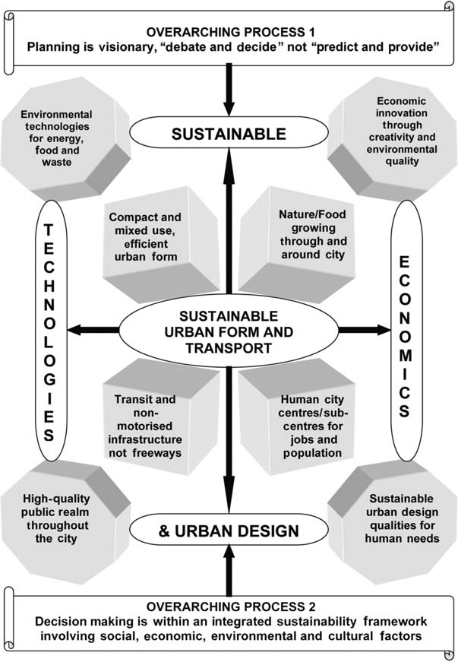

Slide 24
Conclusions
Location of TOD greatly affects potential benefits
  Suburban TOD has smaller effect on VMT than TOD near central core
Parking supply and management is critical to success of TOD
Planners must consider relative risk of areas for increasing densities
  Flood risk
  Transit system risk

Slide 25
Conclusions
TOD will not magically appear
  Zoning changes are needed
  Land assembly problems
TOD can be part of local and regional strategies for growth and transportation management

Slide 26
To effectively reduce transportation externalities, TOD has to focus on more than commute trips
TOD successes are sensitive to housing types, housing tenure and family types

